Slide 1
React - Form

Slide 2
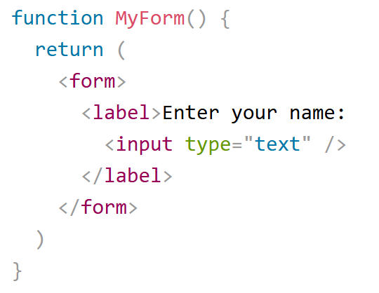
How to add a form
You add a form with React like any other element:

Slide 3
Handling form data
Handling forms is about how you handle the data when it changes value or gets submitted.
In HTML, form data is usually handled by the DOM.
In React, form data is usually handled by the components.
When the data is handled by the components, all the data is stored in the component state.
You can control changes by adding event handlers in the onChange attribute.
We can use the useState Hook to keep track of each inputs value and provide a "single source of truth" for the entire application.

Slide 4
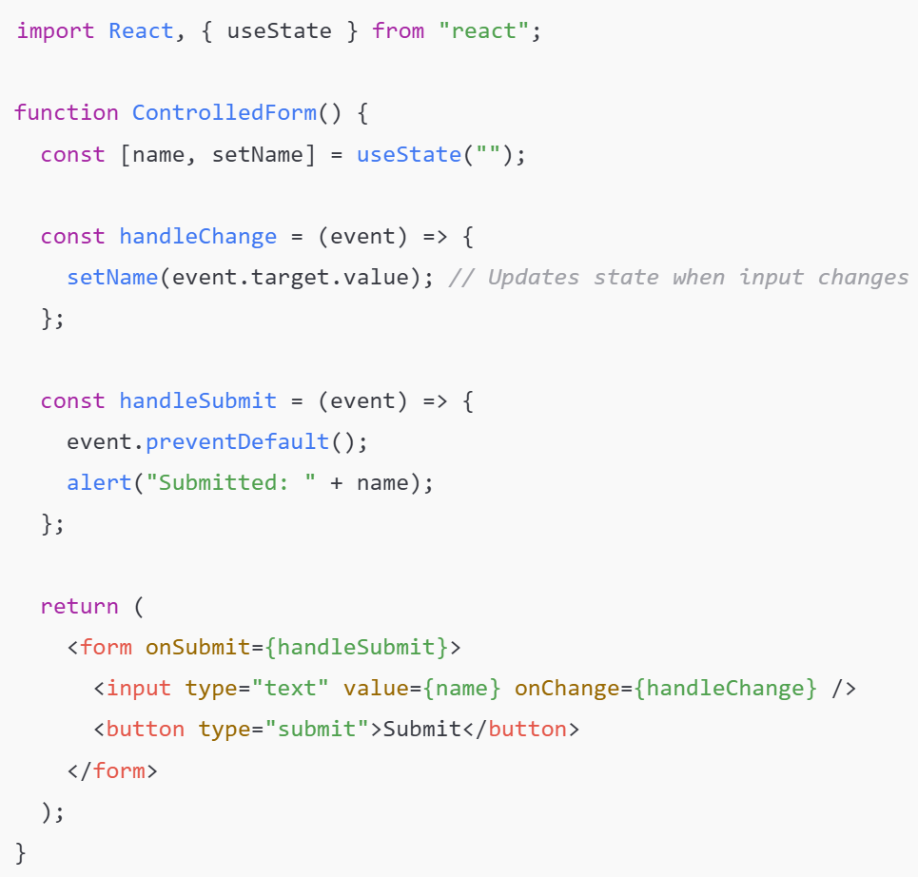
Control components
The form elements are controlled via React state.
React handles the value of the input fields via the useState hook.

Slide 5
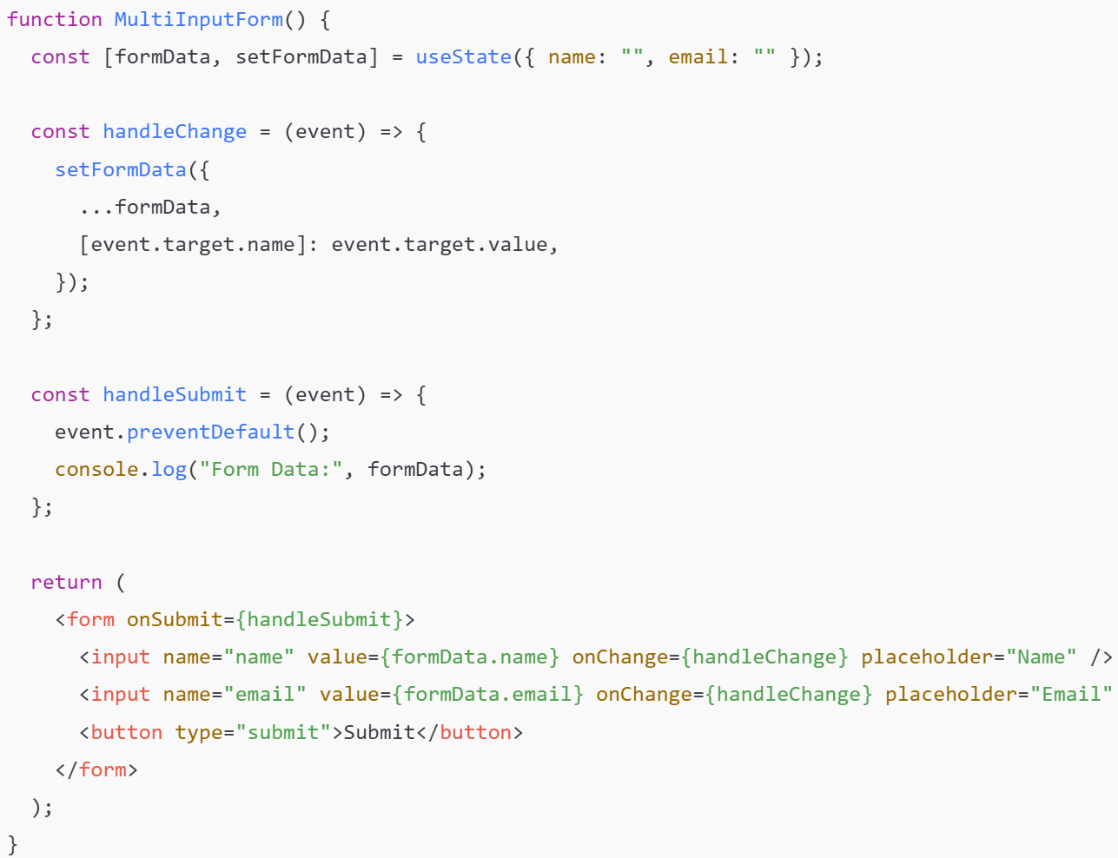
Handling Multiple Inputs
For forms with multiple fields, use an object in state:

Slide 6
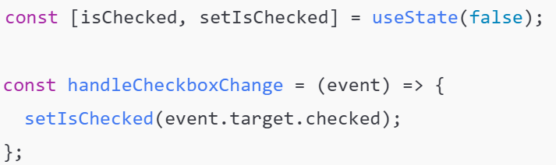
Handling Checkboxes
Use checked attribute to set the value
Use onChange event when check/uncheck

Slide 7
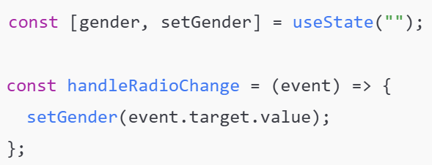
Handling Radio Buttons

Slide 8
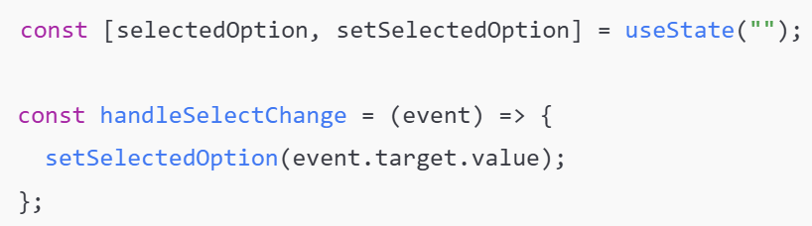
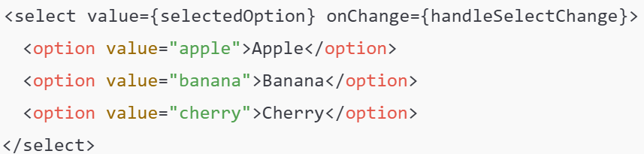
Handling Select Dropdowns

Slide 9
Form validation
You can use Html attributes: https://www.w3schools.com/TAGs/ref_attributes.asp
Formik : https://formik.org/
React Hook Form: https://react-hook-form.com

Slide 10
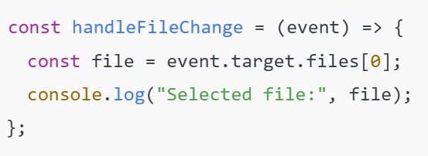
Handling File Uploads
Uploading images, documents, etc.

Slide 11
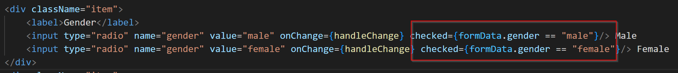
Binding existing data to a form
Use value attribute for input with type :textbox, email, select
Use checked attribute for input with type :radio,checkbox

Slide 12
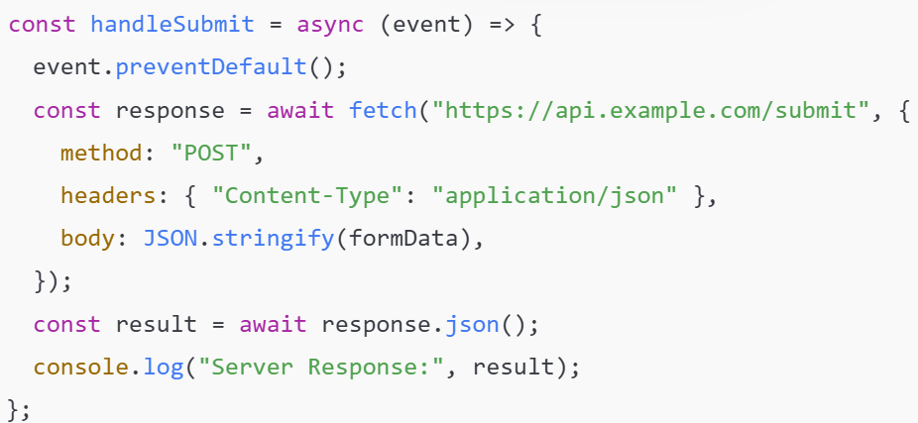
Form Submission & API Calls
If you need to send form data to a backend:

